Slide 1
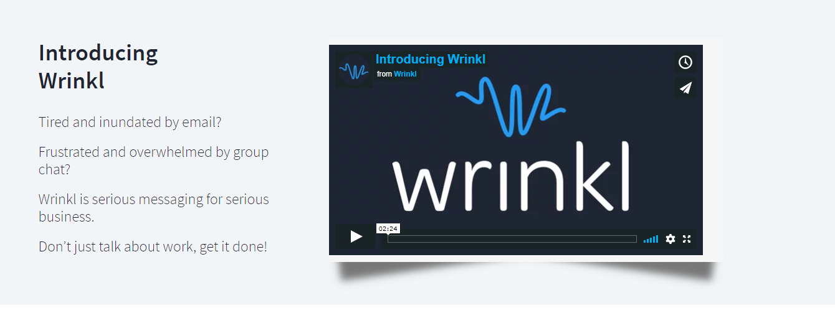
Move video over slightly so text fits on one line

Slide 2
Re-order change “Meet” to “Introducing”
Introducing Wrinkl Essential Tools About Us Jobs Sign-In

Slide 3
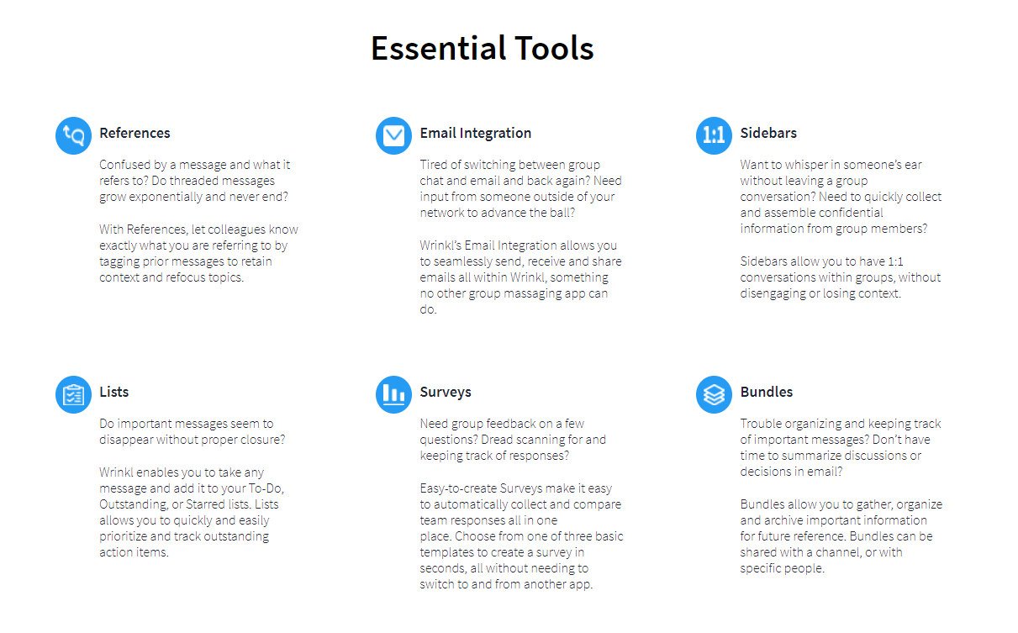
Fix margins so text doesn’t wrap – also why is text not wrapping where it looks like it should?

Slide 4
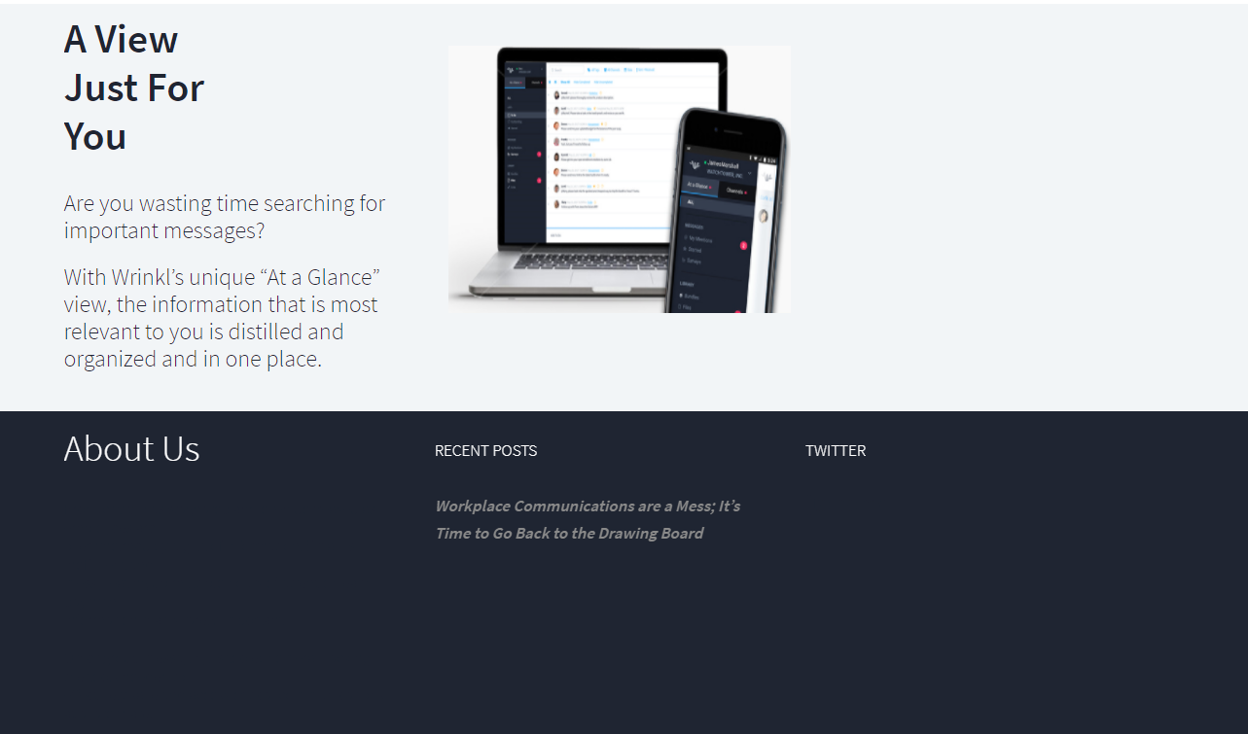
Aspect ratio of image is off – elongate, enlarge and move over slightly

